Slide 1
Sales data analysis

Slide 2
The data contains 9,994 rows and 21 columns, and appears to be part of a sales database. Its details include:Order ID
Order Date
:DateMode:
Customer ID
Customer Name
Segment:
Customer Type
Country, City, State, Postal Code, Region
: Geographic Location
InformationProduct ID, Product Name: Product DetailsCategory, Sub-Category: Product Category and Sub-CategorySales: Sales in DollarsQuantity: QuantityDiscount: DiscountProfit: Net Profit

Slide 3
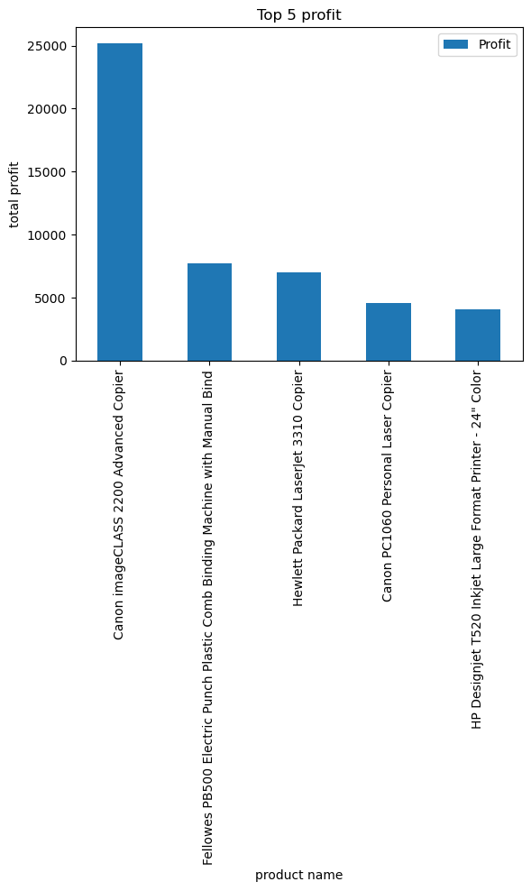
Title: Top 5 profit Horizontal axis (X): Product Name Vertical axis (Y): Total Profit
Explanation:
The chart shows the five highest-profit products, and it shows that:The highest-profit product is the Canon imageCLASS 2200 Advanced Copier, with profits of over $25,000.The other products generate significantly lower profits, in the following order:Fellowes Binding MachineHP LaserJet 3310 CopierCanon PC1060HP DesignJet T520 Printer

Slide 4
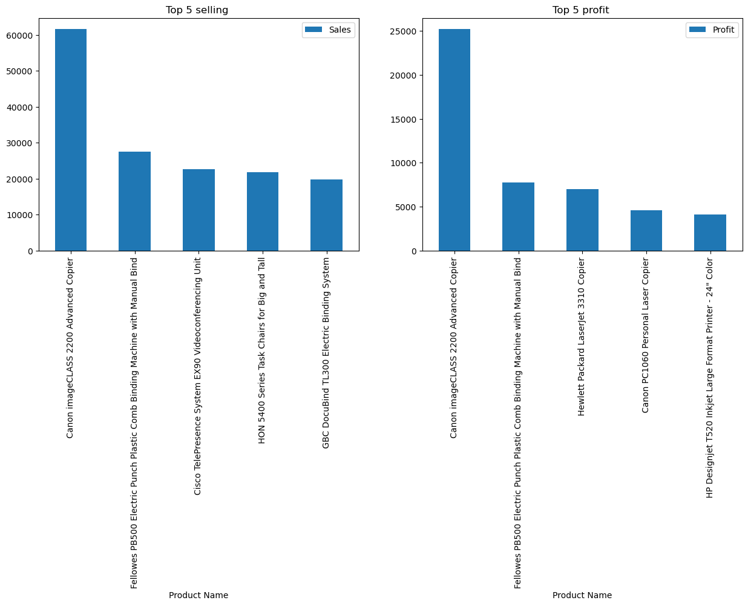
Title: Not shown, but shows the relationship between sales and profits by region .X-axis: Geographic regions (Central, East, South, West) Y-axis: Financial values ​​(Sales and Profit)
Explanation:
This chart compares sales (in blue) and profits (in orange) by region:South has the highest sales and profits.East and West performed well.Central generated sales but showed a loss (negative profits).

Slide 5
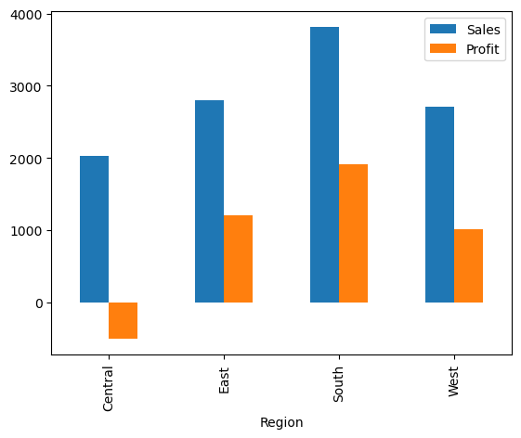
Graphical Representation: This data is likely represented in a bar chart where: Y-axis: numeric values ​​(4000 to 0)X-axis: geographic regions
Possible Conclusions
Regional Performance:Central has the highest performance (4000)
West has the lowest performance (1000 or 0)Geographic Distribution:There is a decreasing gradient in performance from Central to WestInvestigation Points:

Slide 6
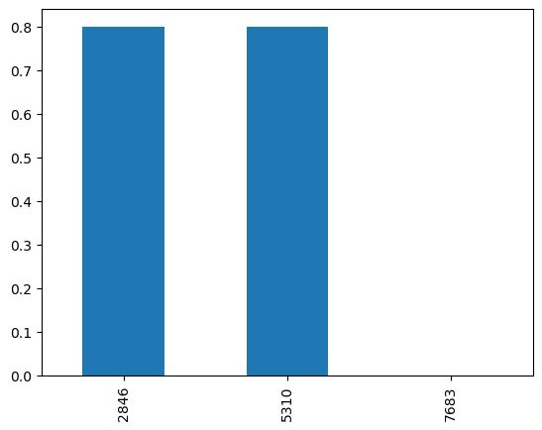
X axis :there are three model Fellowes PB500 Electric Punch Plastic Comb Binding Machine with Manual Bind y_axis:three discount to model eplain :The company loses when it sells its Fellowes PB500 Electric Punch Plastic Comb Binding Machine with Manual Bind products in the Central! as it make 80% discount on 2 products from 3 products

Slide 7
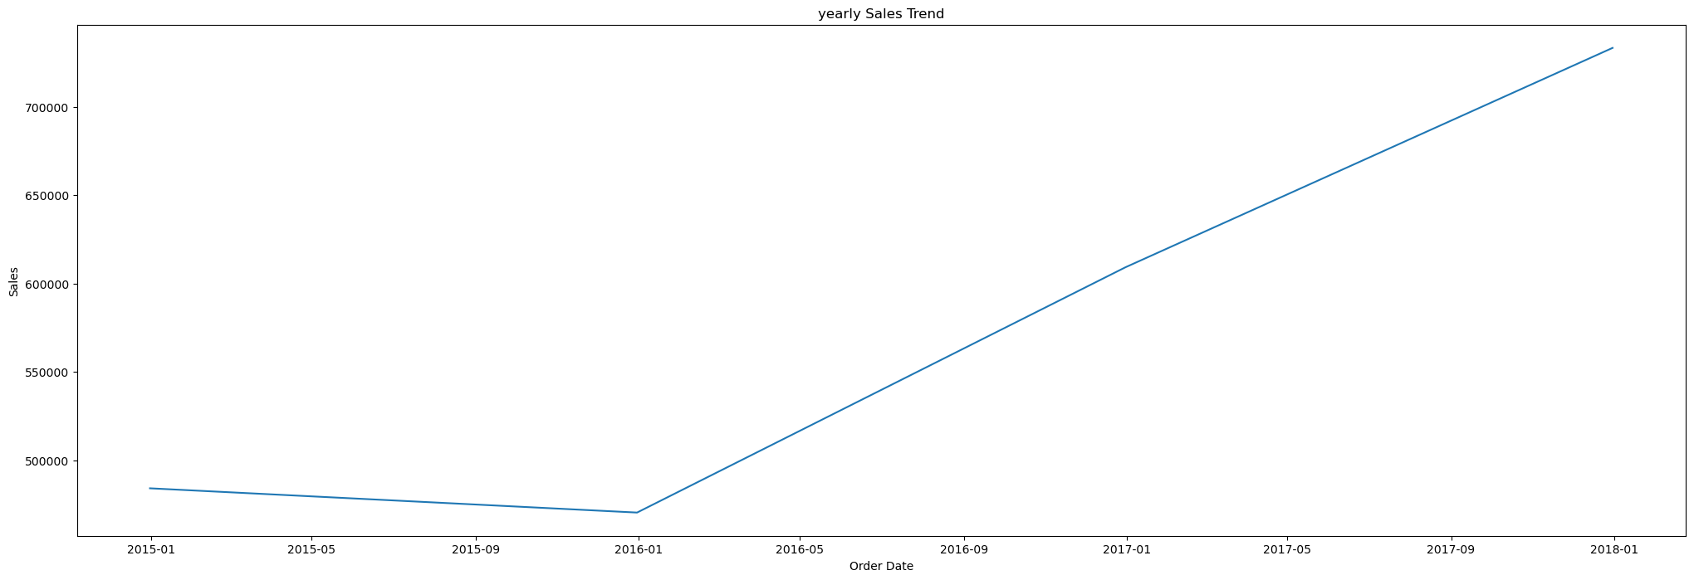
The annual form shows that the company is profitable in general compared to the years.

Slide 8
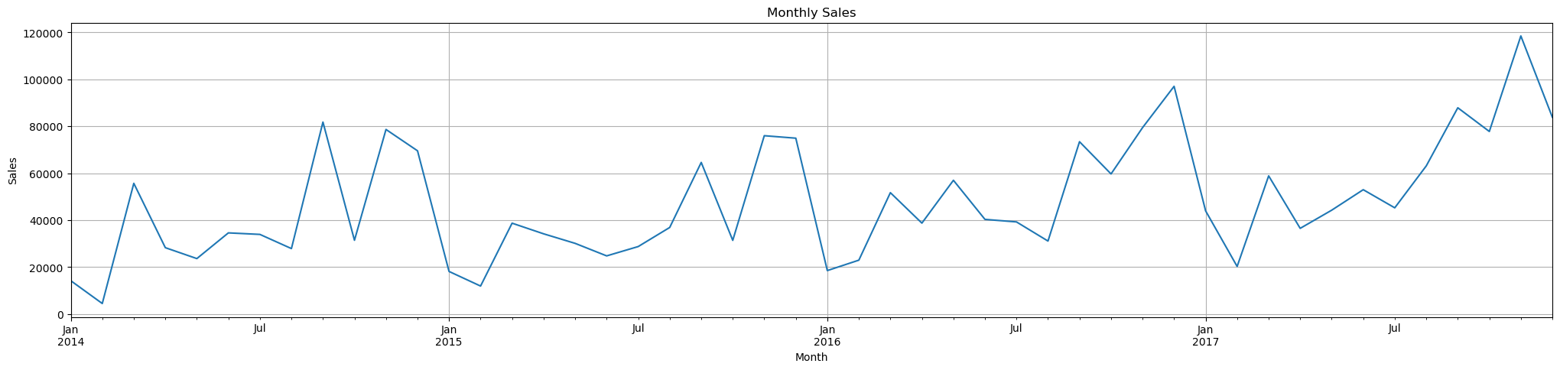
X axis:order data yaxis :sales In this chart, I have collected all the months in which this product was followed. It is clear from this that it made a profit, and the reason for the decrease in profits is the discontract.

Slide 9
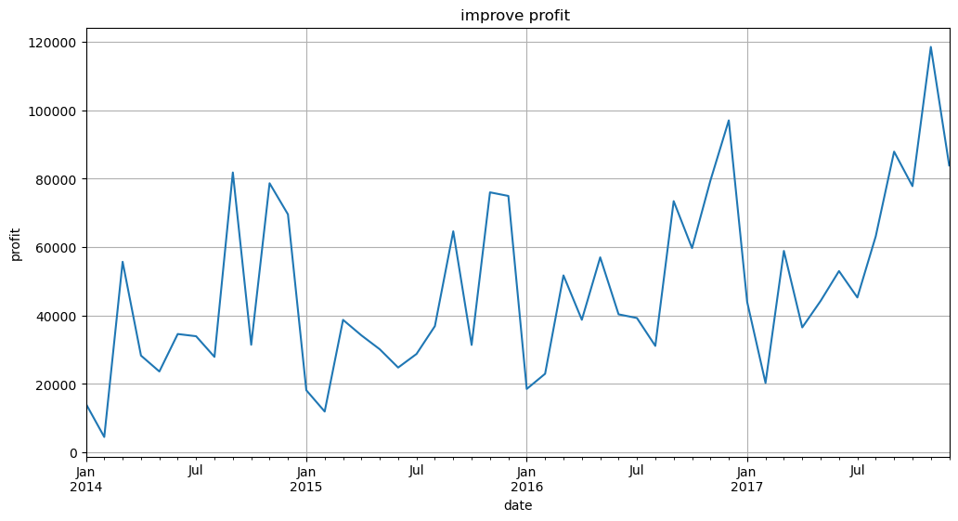
It is clear that the profit is high, but not like sales, and that is only due to the discounts.

Slide 10
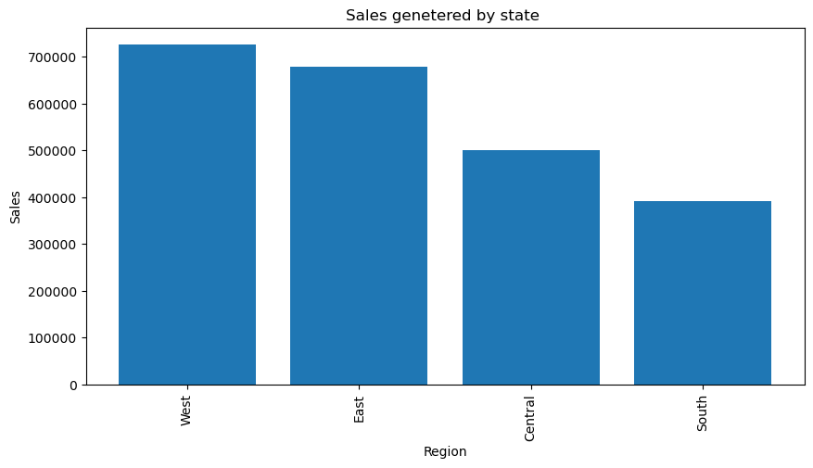
Here we explain the areas that achieve the highest sales percentage, and it is clear that the highest sales percentage is in west

Slide 11
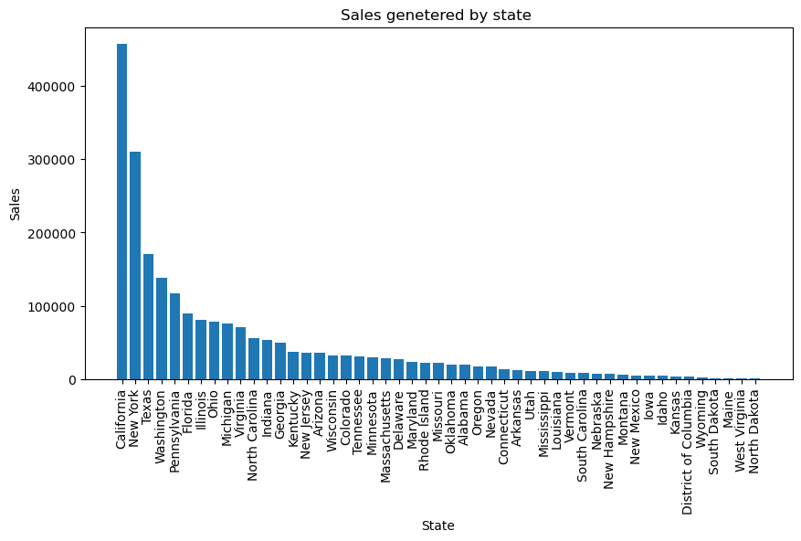
From this figure it is clear that California has the highest sales percentage.

Slide 12
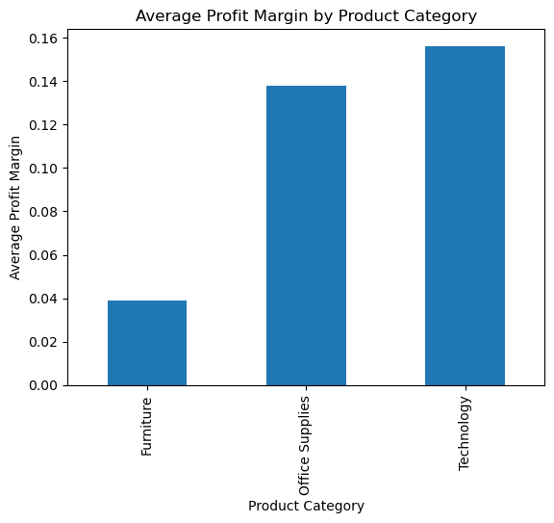
This chart shows the average profit margin for each of the three product categories:Furniture – lowest profit margin, approximately 0.04 (4%).Office Supplies – average profit margin, approximately 0.138 (13.8%).Technology – highest profit margin, approximately 0.157 (15.7%).Conclusions:The technology category is the most profitable in terms of margin, making it the most attractive category for profit enhancement.Furniture is the least profitable, with a weak margin and may require pricing revisions or cost reductions.Office Supplies strikes a good balance between potential sales and profit margin.

Slide 13
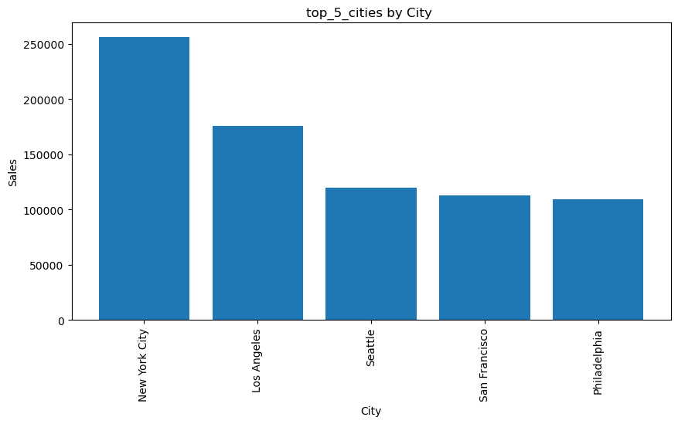
Title: Average Sales by DiscountDescription:This chart shows average sales by discount percentage.It shows that:At a discount of 0.5 (50%), sales were at their peak.At high discounts, such as 0.6 and 0.8, sales were very low.Moderate discounts (0.1 to 0.45) generally recorded similar sales, while the discount of 0.2 was the weakest.

Slide 14
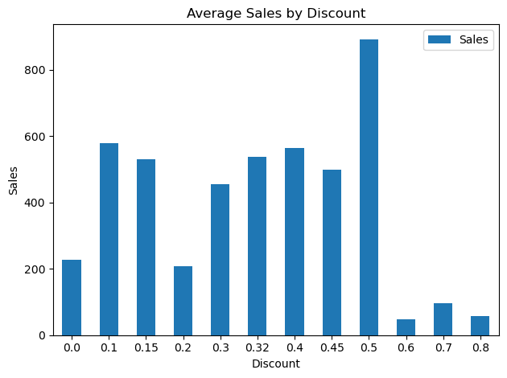
Title: Average Sales by DiscountDescription:Same as the horizontal axis (discount) , but here it shows total sales, not the average, as the values ​​suggest.Sales at a discount of 0.0 (no discount) are by far the highest, followed by a discount of 0.2.The remaining discounts result in very low sales by comparison.Note: This large variation indicates that the discount is not necessarily associated with increased sales, and the number of transactions or products at each discount may have an effect.

Slide 15
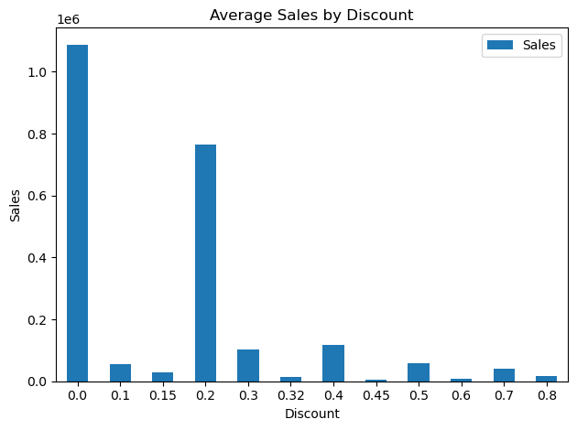
Title: Average Sales by DiscountDescription:Same as the horizontal axis (discount), but here it shows total sales, not the average, as the values ​​suggest.Sales at a discount of 0.0 (no discount) are by far the highest, followed by a discount of 0.2.The remaining discounts result in very low sales by comparison.Note: This large variation indicates that the discount is not necessarily associated with increased sales, and the number of transactions or products at each discount may have an effect.

Slide 16
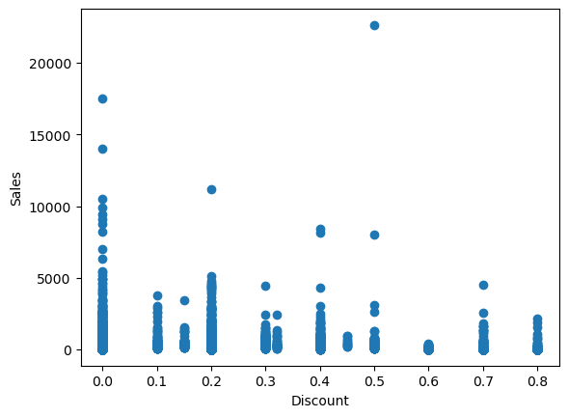
Horizontal axis: Discount percentageVertical axis: Sales valueAnalysis:Most data points cluster at discounts between 0% and 0.2%.At 0%, we observe some very high sales values ​​(over 20,000).As the discount increases, sales value tends to decrease or disperse.There does not appear to be a clear linear relationship between discounts and sales.It can be argued that a high discount does not guarantee increased sales—in fact, some high discounts have been associated with low sales.

Slide 17
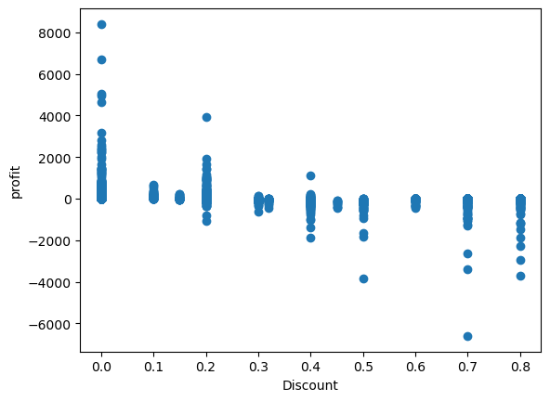
Horizontal axis: DiscountVertical axis: Sales after a conversion or adjustment (perhaps the difference between expected and actual sales, or the value after deducting costs)Analysis:Some values ​​have become very negative (below -6000), especially with high discounts.With a high discount (0.6 - 0.8), there are clear losses or a sharp decline in sales value.At a 0% discount, most values ​​are positive or stable—meaning that not having a discount can be more profitable.

Slide 18
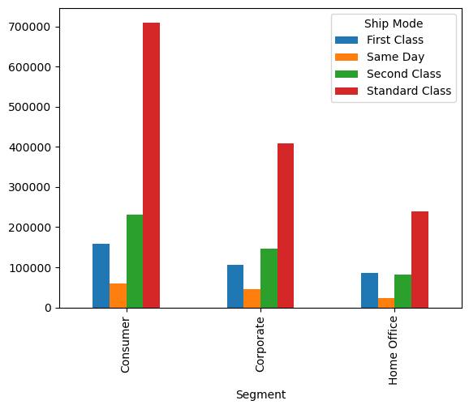
Horizontal (X) axis: Customer segments (Segments):ConsumerCorporateHome OfficeVertical (Y) axis: Gross profit. Explanation: The Consumer segment generates the highest profits, especially when using Standard Class.The Corporate segment generates good profits.The Home Office segment generates the lowest profits compared to the other segments.The Standard Class shipping method is the most profitable of all segments.

Slide 19
Plot on the left: Mean Squared Error (MSE)This represents the average squared difference between the actual and predicted values ​​(the lower the value, the better the model).Shorter bars indicate better performance.
Notes:SVR and Random Forest had the lowest MSE → Best accuracyLasso, Ridge, and Linear Regression had the worst MSE → Not a good fit for the data Plot on the right: R² ScoreMeasures how well the model explains the variance in the data (ideal value = 1)If the value is negative, it means the model is worse than simply predicting the mean.
Notes:Almost all models yielded weak or negative results in R² → the data may be nonlinear or contain noise.SVR was the only model that achieved a positive R² (even if slight) → the best accuracy.Random Forest also had a close to zero → better than the others
. Conclusions:The best model based on the graph is:Support Vector Regressor (SVR) in terms of both MSE and R².Random Forest performed well in MSE, but had a weak R².Linear models (Linear, Ridge, Lasso) are likely inappropriate due to the nature of the data.

Slide 20
